Slide 1

S.Ryyan Shifa

Slide 2

Determining Customer Creditworthiness with Decision Trees

Slide 3

Problem statement
Project overview
Who are the end users
Your solution and its valu proposition
The wow in your solution
Modelling
Result

Slide 4

Financial institutions face the challenge of accurately assessing the creditworthiness of customers to mitigate the risk associated with lending. The objective of this project is to develop a predictive model using decision trees to determine whether a customer is likely to be creditworthy based on various attributes such as income, employment status, and credit history.

Slide 5

In today's financial landscape, the ability to accurately evaluate customer creditworthiness is paramount for prudent lending decisions. This project endeavors to address this challenge by harnessing the power of decision trees, a versatile and interpretable machine learning algorithm, to predict whether a customer is creditworthy.

Slide 6
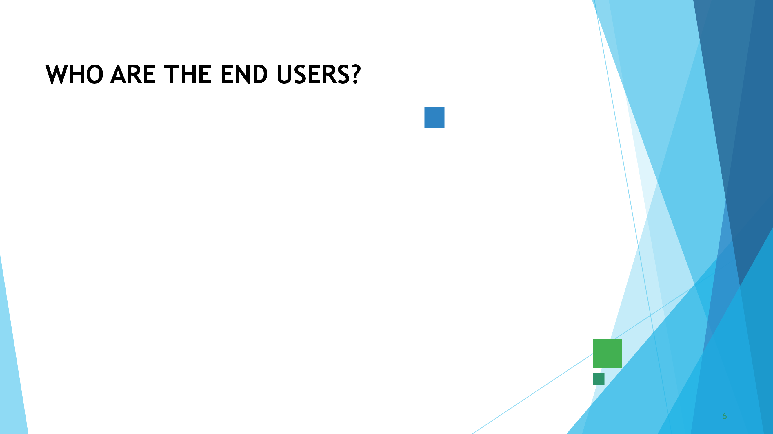
In the context of determining customer creditworthiness with decision trees, the end users can be categorized into several groups, each with distinct roles and responsibilities
Financial Institutions
Regulatory Bodies
Customers
Data Scientists and Analysts
Management and Decision Makers

Slide 7
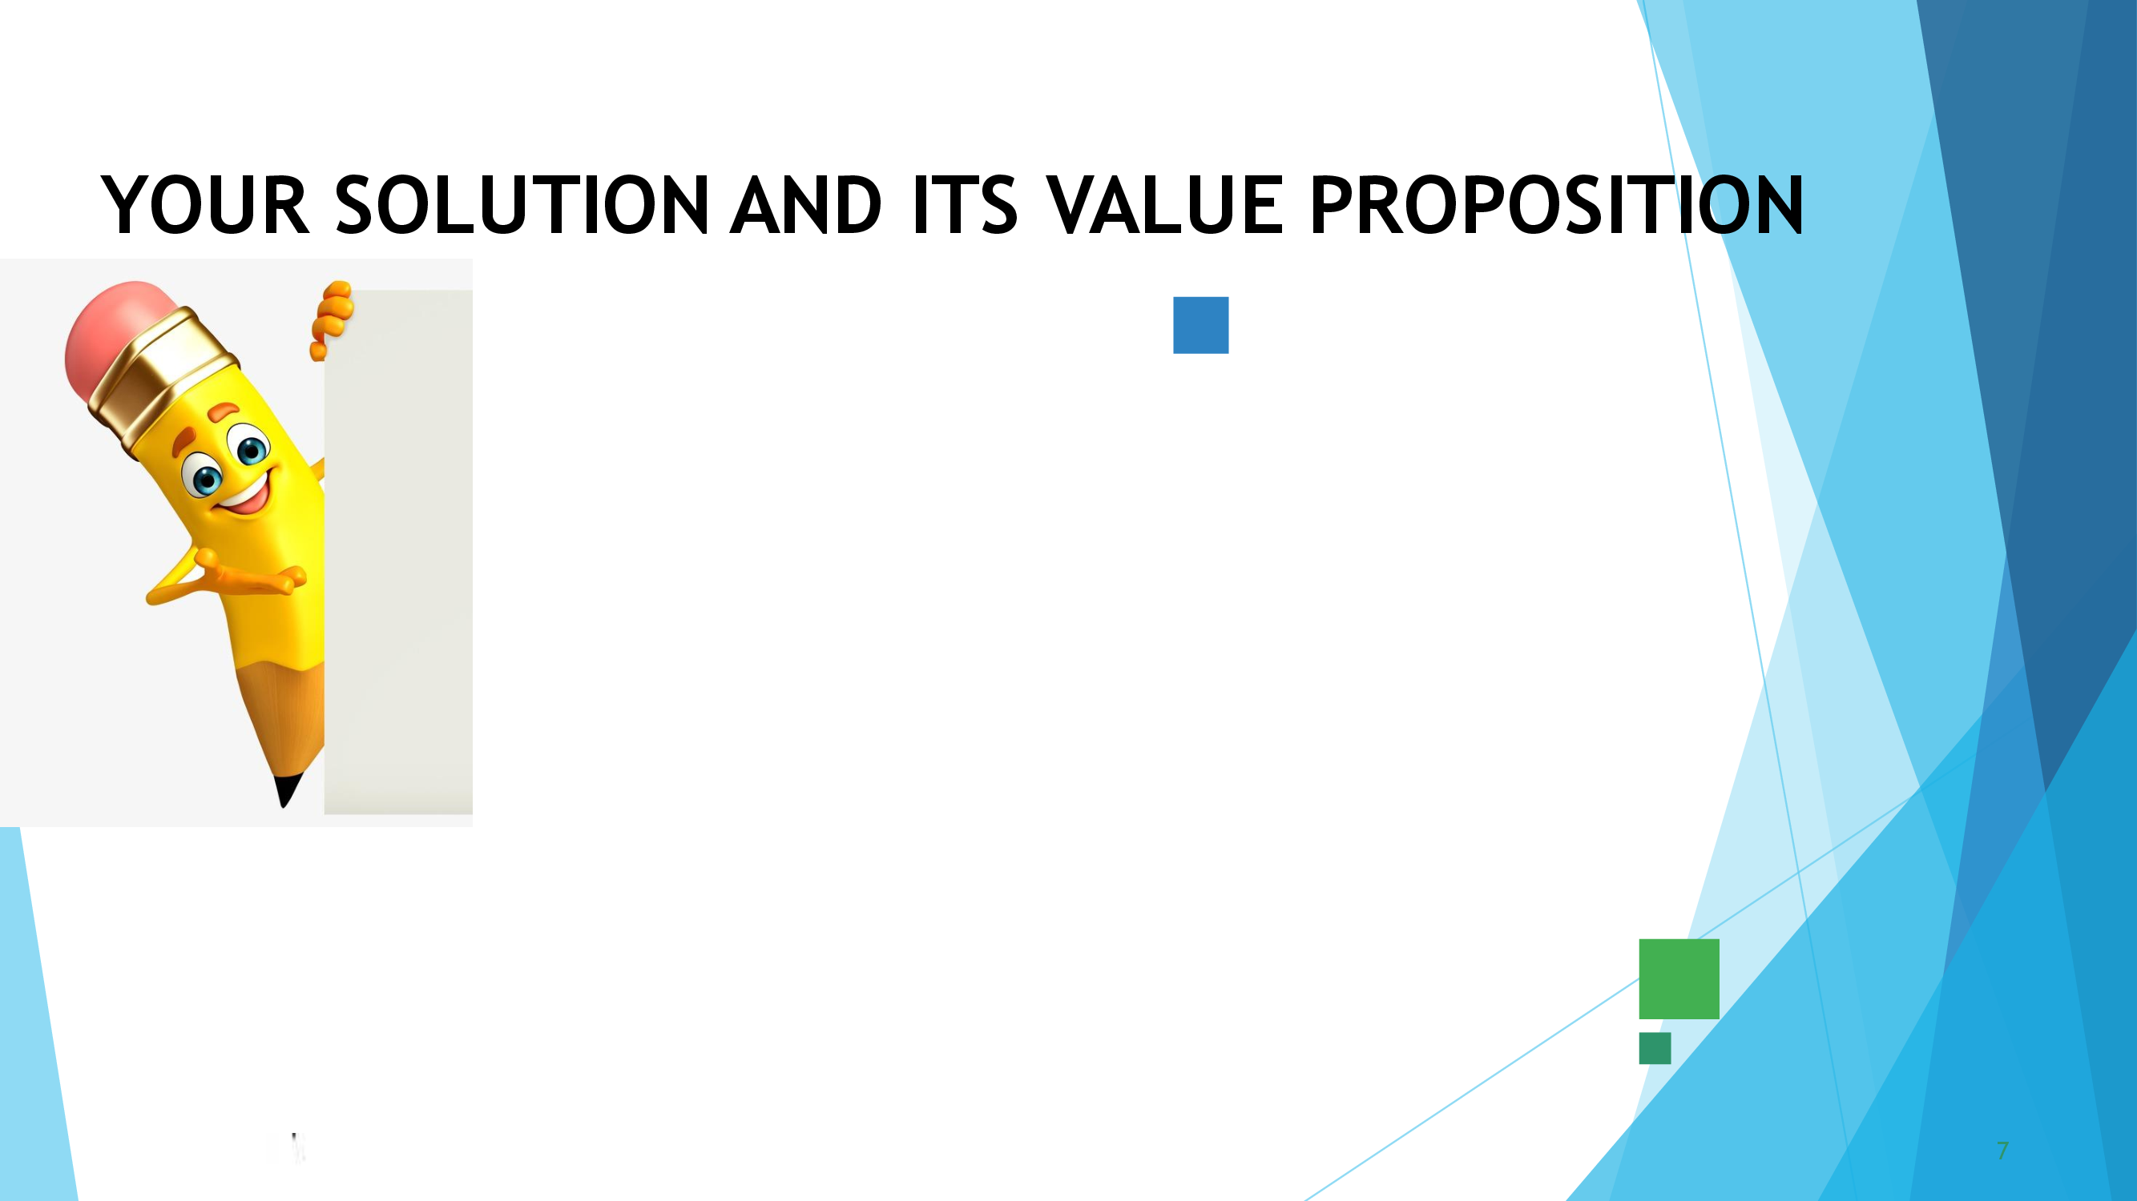
The solution involves developing a predictive model using decision trees to assess the creditworthiness of customers applying for loans or credit. By leveraging historical customer data and machine learning algorithms, the solution aims to provide financial institutions with a reliable tool for making informed lending decisions while mitigating credit risk.

Slide 8

In addition to its core functionalities and value propositions, the solution boasts several standout features that contribute to its WOW factor:
Interactive Decision Tree Visualization
Explainable AI (XAI) Capabilities
Dynamic What-If Analysis
Personalized Customer Insights Dashboard
Continuous Model Improvement and Adaptation
Gamification Elements for User Engagement

Slide 9

Modeling Process:
1. Data Preprocessing:
2. Train-Test Split
3. Build Decision Tree Model
4. Hyperparameter Tuning
5. Model Evaluation
6. Model Interpretation
7. Optional: Ensemble Methods
8. Validation and Fine-Tuning
9. Deployment
10. Monitoring and Maintenance
11. Documentation
12. Communication

Slide 10

The result of the solution for determining customer creditworthiness with decision trees would be a predictive model that accurately assesses whether a customer is likely to be creditworthy based on various attributes. Here are some specific outcomes and results that can be expected:
Model Performance Metrics
Interpretation of the Decision Tree Model
Visualization of the Decision Tree
Model Deployment and Integration
Validation and Monitoring
Impact on Lending Decisions and Risk Management
Customer Outcomes and Satisfaction

